Slide 1
PROCESSES

Slide 2
Directing a Project
The purpose of the Directing a Project Process is to enable the Project Board to be accountable for the project by making key decisions, and to have overall control
Objective:What are the objectives of Directing a Project?
The objectives of Directing a Project Process are to: Provide authority to initiate the project.
Provide authority to deliver the project’s products. The products are the reason to do the project.
Provide direction and control during the project.
Be the interface to Corporate or Program Management. Provide authority to close the project.
Ensure that post-project benefits will be reviewed.

Slide 3
Directing a Project
The key activities in this process are:
There is appropriate authority to initiate the project There is authority to deliver the project products
The project remains viable and management direction and control are in place throughout the projects life.
The project board executive Interface is regularly with corporate or programme management
There is authority to close the project
A benefit review plan for realizing the post project benefits is created, managed and reviewed.
The Directing a Project process starts when the Starting Up a Project process completes and is triggered by the request from the project manager to initiate a project.
The project board uses the technique management by exception. It monitors via reports and provides control via a number of the decision points.

Slide 4
Directing a Project
For management by exception to work, the project board must set tolerance, and if at any point this is forecasted to be exceeded, the project manager will inform the project board via an Exception Report to bring the situation to the project board’s attention.
With management by exception there is no need for progress meetings. As already mentioned there must be an information conduit between the project board and corporate or programme management, how this is to occur should be documented in the Communication Management Strategy.
Although it is the executive of the project board who has the veto on any decisions and direction given, the project board should provide a unified direction and guidance to the project manager and other key stakeholders. The project board is responsible for assuring that there is continued business justification, and this is why the project Board Executive owns the project Business Case.

Slide 5
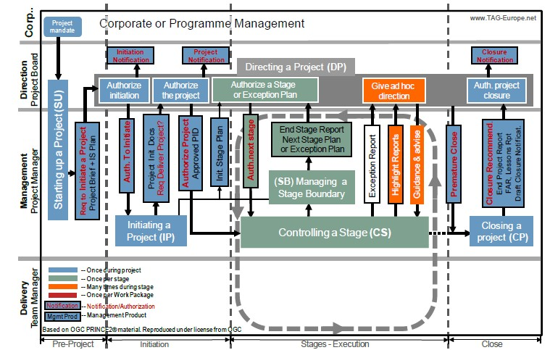
Directing a Project

Slide 6
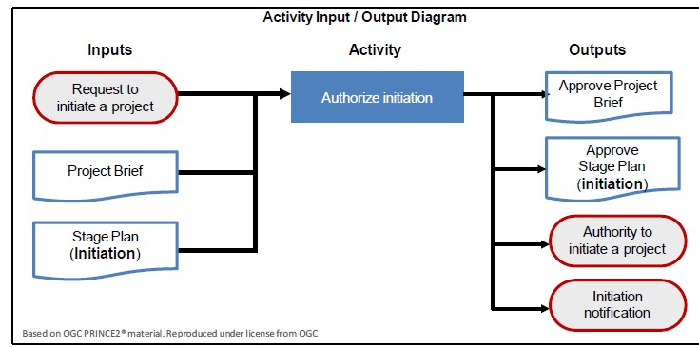
Directing a Project

Slide 7
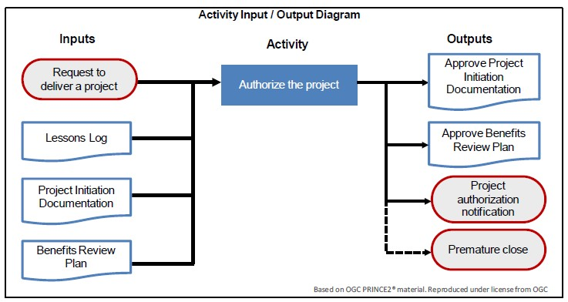
Directing a Project

Slide 8
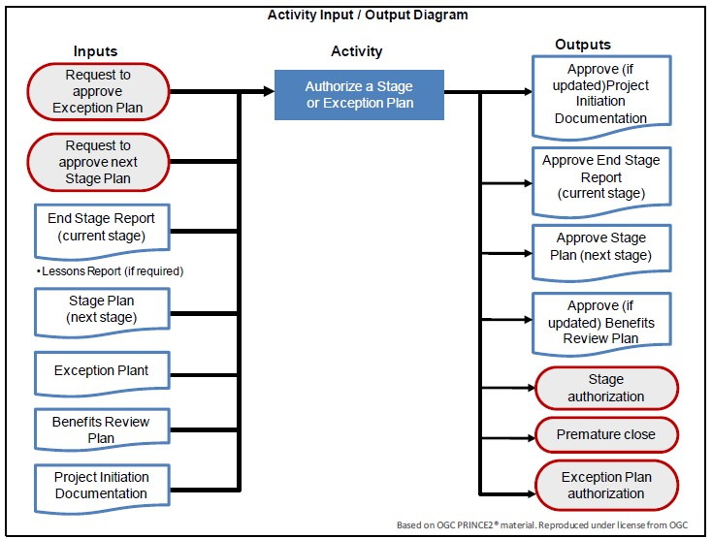
Directing a Project
Directing a Project

Slide 9
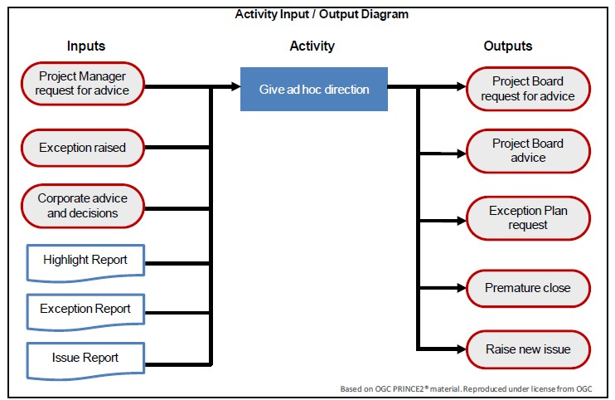
Directing a Project

Slide 10
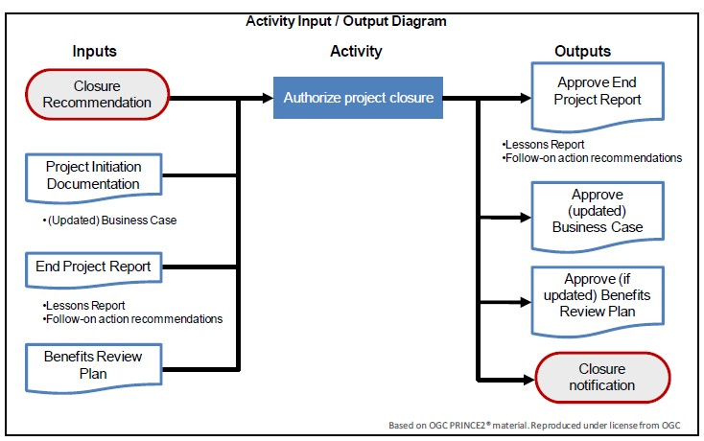
Directing a Project

